Slide 1
A Mini Project Report on “Battery level indicator by Arduino”
Bachelor of Engineering in Electronics and Telecommunication SUBMITTED BY: 1. Mr. Amit Shashikant Kharade ROLL NO.52 2. Mr. Shubham Balvant Doke ROLL NO.53 UNDER THE GUIDANCE OF DR. JOHN ASHOK

Slide 2
INTRODUCTION
All batteries have certain voltage limit to discharge, if it goes beyond the prescribed limit, the life span of the battery will reduce drastically.
Being electronics enthusiasts, we all might have a battery for testing our prototype circuits. Since we concentrate on the prototype during experiment, we care less on the battery.
The proposed battery charger circuit will show you how much energy left in the battery, this circuit may be connected to battery, while you prototyping your circuits. When this circuit indicates low battery, you may put the battery to charge. The circuit has 6 LEDs, one LED glow at a time to indicate the voltage level of the battery.

Slide 3
CIRCUIT COMPONENTS:
1) ARDUINO UNO
Arduino is an open-source physical platform based on microcontroller board having the ATmega32 series controllers and Integrated Development Environment for writing and uploading codes to the microcontroller. It has input and output pins for interaction with the outside world such as with sensors, switches, motors and so on. To be precise it has 14 digital input/output pins (of which 6 can be used as PWM outputs), 6 analog inputs, a 16 MHz quartz crystal, a USB connection, a power jack, an ICSP header and a reset button. It contains everything needed to support the microcontroller .It can take supply through USB or we can power it with an AC-to-DC adapter or a battery Arduino acts as the processing module of system. It takes input from the LDR, process the data and gives the output to LEDS directly or through a relay and a transistor mechanism

Slide 4
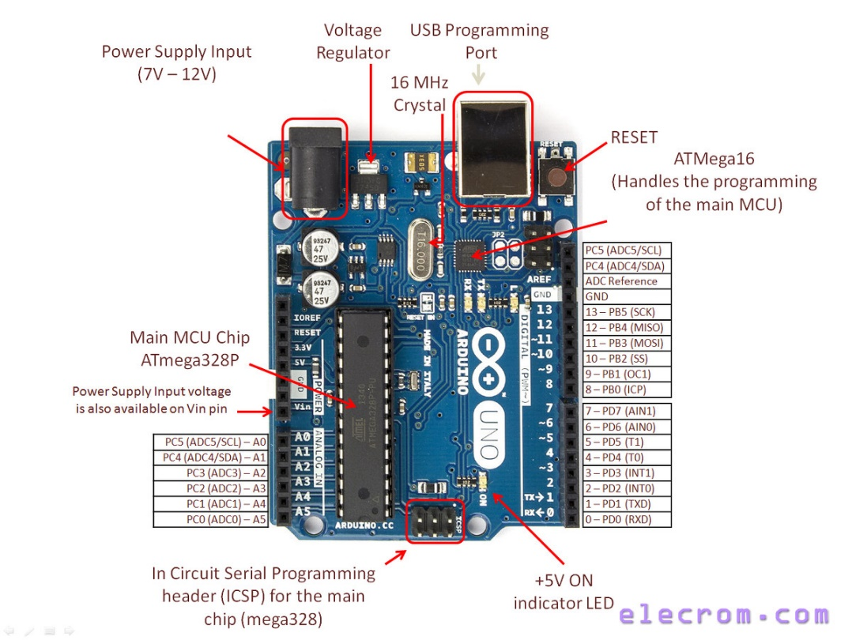
ARDUINO UNO

Slide 5
CIRCUIT COMPONENTS:
2) LEDS
A light-emitting diode (LED) is a pn junction diode, which emits light when activated. When we apply voltage across its leads, electrons are able to recombine with holes within the LED, releasing energy in the form of photons which gives the light. Hence, it is a two-lead semiconductor light sourceLight emitting diodes represents our lighting system and the amount of light emitted by it is directly related to the amount of light in the environment that is when outside light is less than the light given by LEDS is more and visa-versa.

Slide 6
WORKING PRINCIPLE
Set the voltage of your variable power supply to precisely to 12.50V.
Open the serial monitor.
Rotate the present resistor clock wise or counter clock wise and bring the readings to 12.50V.
Now, reduce the variable power supply to 12.00V, the readings on the serial monitor should show the same or very close to 12.00V
Now, increase the voltage to 13.00V, the readings on serial monitor should also show the same or very close.
At the same time when you increase or decrease the voltage, the each LED should turn on/off with different voltage levels.
Once the above steps are done successfully, your battery level indicator circuit will be ready to serve the intended purpose.

Slide 7
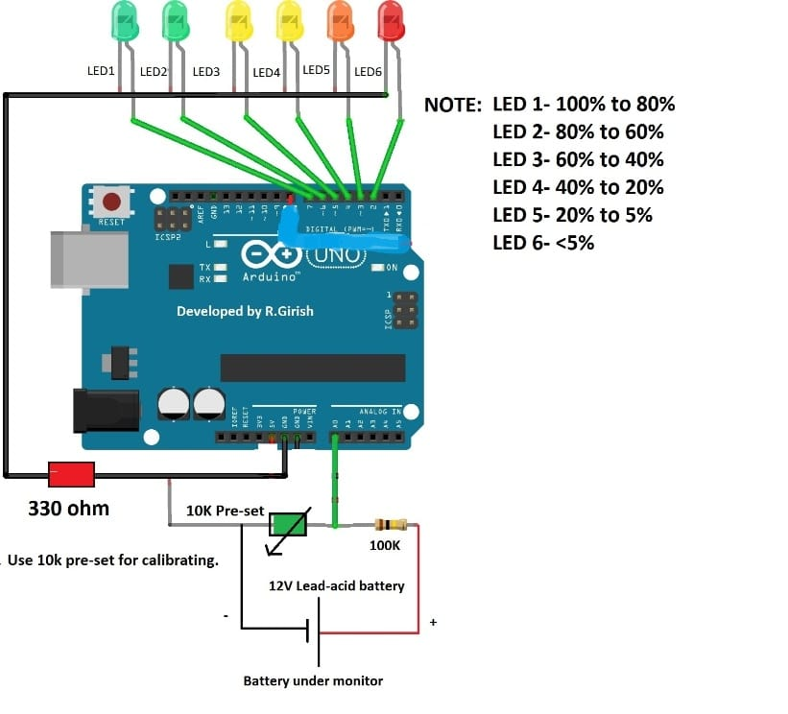
SCHEMATICS VIEW:

Slide 8
ADVANTAGES
A battery level indicator is with electronic appliances to arrange as to display, on an indicator, a real time voltage detected by voltage indicator.
Indicator indicates how much power the battery will be able to supply to electronic apparatus.
It is used to check the battery level with the help of LED’s for example if three LED’s, indicates battery capacity of 30 percent. And if 6 LED’s glow then it is 100 percent.
Easily indicate the battery level
Enhanced version of this circuitry is the present mobile phone battery level indication system
This circuit can be used in household applications like INVERTER. This circuit connected to inverter can help the users to know when to charge and when to leave the inverter idle
Minimized version of this circuit can be also used for automobiles to indicate the battery level and low cost.

Slide 9
FUTURE SCOPE
This project can be further extended in a useful manner, The basic design of battery level indication using single Arduino board can be further improved by adding display control function and alert mechanisms to enable the easy knowing of the battery level. Instead of using the LED’S and LED controller in this circuit using a microcontroller can enable battery level indication as in mobile phones.

Slide 10
CONCLUSION
This Arduino based project will provide a competent method for charging systems and make the whole process of energy saving indication. The battery level indicator consists of very less component and thus occupies very little space of the surrounding. Since only DC input voltage levels are indicated, components which work in AC supply can be used to detect AC levels. Since AC voltage having continuously varying amplitudes the leds will turn ON and OFF continuously making a good looking pattern. Thus our battery level indicator can be used for decoration purpose also.

Slide 11
THANK YOU

